Slide 1
Machine Learning for automated coherent structure Identification and super resolution in turbulent flows.
Seminar for Argonne National Laboratory, October 5th, 2021
Sahil Kommalapati | MS thesis research
Conducted at the Williams Turbulence Laboratory, William E. Boeing Department of Aeronautics and Astronautics.
Notes:
I really cherish this opportunity as it is a wonderful stage to showcase my research to such an impactful community of researchers.
I had a lot of fun working on this research and I believe that they are very important problems in the turbulence community and I am really looking forward to your thoughts and feedback on this work.
So, today I will speak on my MS thesis research
Which focuses on Machine Learning tools for automated coherent structure Identification and super resolution in turbulent flows.
I am Sahil Kommalapati and this research was conduceted at the Williams turbulence lab at the university of Washingotn’s Aeronautics and Astronautics dept.

Slide 2
Broad Objectives
Bayesian Inference for turbulent coherent structure Identification on PIV measurements of smooth wall-bounded boundary layer flows.
Shallow Neural Networks for super resolution in PIV measurements of turbulent separated flows over Gaussian speed bump geometry.
Notes:
Two main objs of my research
Bayesian Inference for turbulent coherent structure Identification on PIV measurements of smooth wall-bounded turbulent boundary layer flows.
Shallow Neural Networks for super resolution in PIV measurements of turbulent separated flows over Gaussian speed bump geometry.
Ill begin the first objective with an introduction to tcs

Slide 3
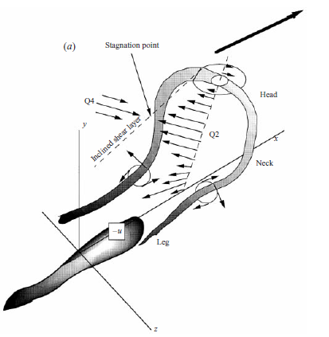
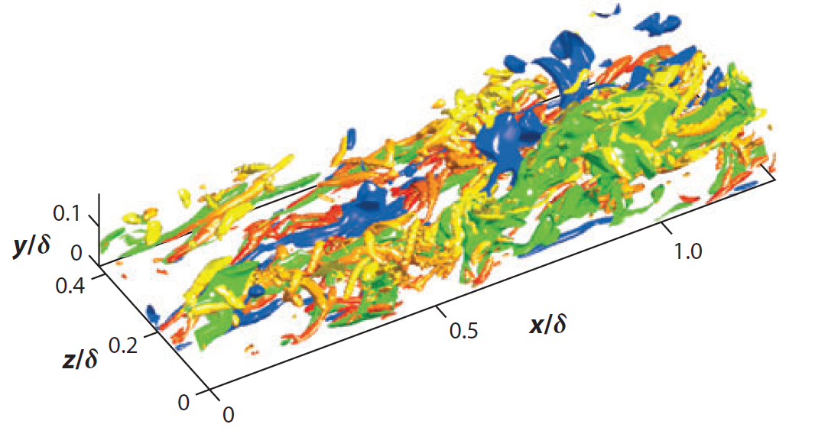
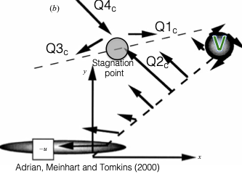
Introduction
*Adrian, Ronald J., Carl D. Meinhart, and Christopher D. Tomkins. "Vortex organization in the outer region of the turbulent boundary layer." Journal of fluid Mechanics 422 (2000): 1-54.
Turbulence is composed of a wide variety of structures at multiple scales that combine to produce the observed macro-scale effects.
Hairpin vortex structures are one of these elemental units that contribute to the production of turbulence in wall bounded flows.
2D projection on a plane slicing along the stream wise direction.
Jiménez, Javier. "Cascades in wall-bounded turbulence." Annual Review of Fluid Mechanics 44 (2012): 27-45.
A Hairpin vortex structure.*
A snapshot of turbulent flow – Reynolds stress field.
Notes:
Turbulence is composed of a wide variety of structures at multiple scales that combine to produce the observed macro-scale effects.
These structures are both spatially and temporally coherent and are simply referred to coherent structures.
Hairpin vortex structures are one of the most ubiquitously found coherent structure
And it is found in turbulent flows that are wall bounded
These are elemental units that contribute to the both the production and sustenance of turbulence
An example of wall bounded flow is shown in the first figurer which shows a contour of the Reynolds stress field.
This field is composed of a lot of Hairpin vortex candidates
A theoretical diagrams of an isolated structure is in the middle, with a notable horse shoe shaped vortex: with a head and two tails.
If we take a look at the cross section of a hairpin structure in the third figure, it made up of a vortex V and a Stagnation point.
This combination is considered as the signature of a hairpin vortex.
These cross sectional projections are easily obtained with PIV mesurements and my primary goal is to identify these vortices that make up the hairpin vortex signature.
To remove any ambiguity, I should mention that identification and modelling of a stagnation point is out of scope for this work. And only focus is on vortex identification in boundary layer piv data.

Slide 4
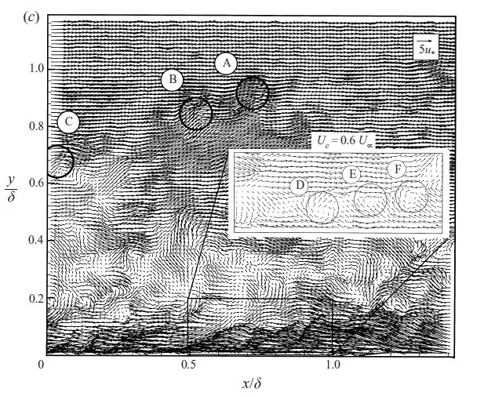
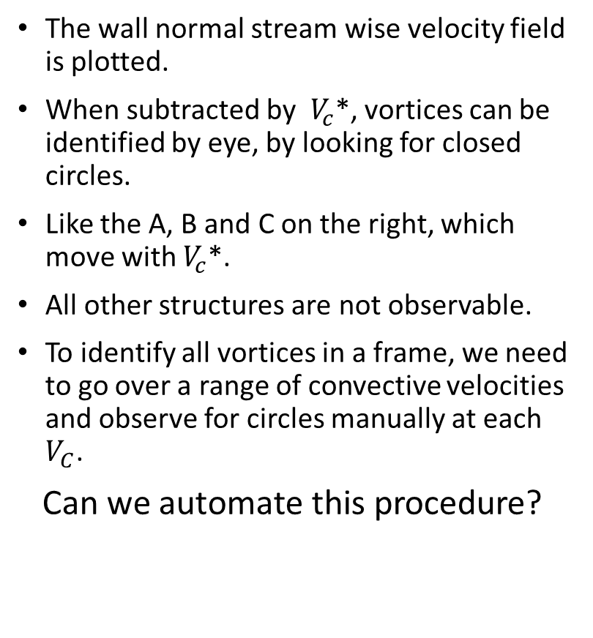
Identifying hairpin vortices by hand.
*Adrian, Ronald J., Carl D. Meinhart, and Christopher D. Tomkins. "Vortex organization in the outer region of the turbulent boundary layer." Journal of fluid Mechanics 422 (2000): 1-54.
The wall normal stream wise velocity field is plotted.
When subtracted by $V_{c}$*, vortices can be identified by eye, by looking for closed circles.
Like the A, B and C on the right, which move with $V_{c}$*.
All other structures are not observable.
To identify all vortices in a frame, we need to go over a range of convective velocities and observe for circles manually at each $V_{C}$.
Can we automate this procedure?
Notes:
I will quickly go over how one would identify a hairpin hairpin vortex by hand.
This methods was proposed by Ronald Adrian in 2001.
We begin with a
The wall normal stream wise velocity field. This is something that we can get using PIV. An example is show on the right.
When this field is subtracted by the a certain velocity ($V_{c}$*), vortices can be identified by eye, by looking for closed circles in velocity vectors.
As seen in the red circle, when subtracted by 0.6 times the freestream velocity, we observe the vortices titled as A, B and C.
The other structures not convecting at Vc* are not visible.
To identify all vortices in a single, we need to go over a range of convective velocities and observe for circles manually at each $V_{C}$
Extremely laborious, doesnot scale with massive datasets and to identify a particular vortex, would requires the prior knowledge of $V_{c}$ of structure.
So,
How do we automate this procedure?

Slide 5
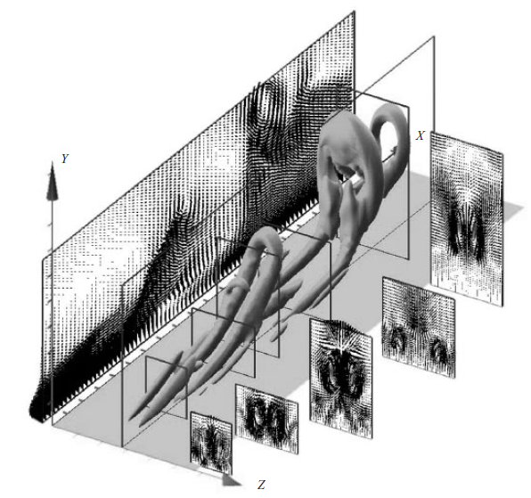
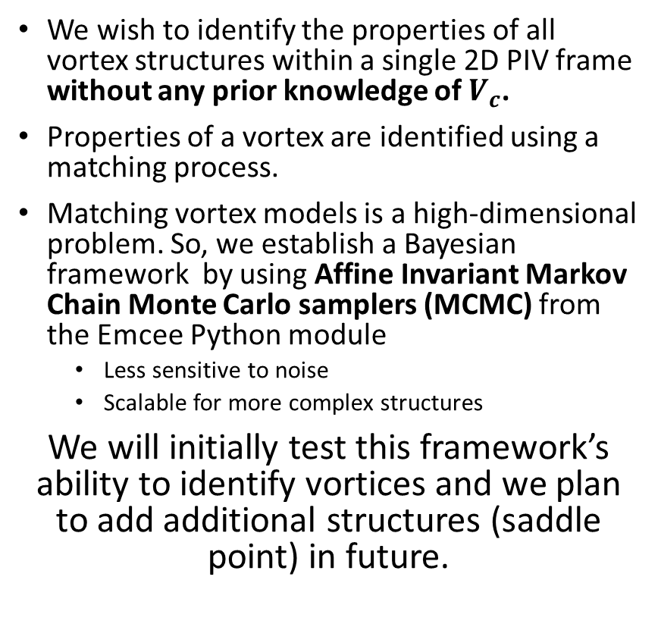
Objectives for current work.
*Adrian, Ronald J., Carl D. Meinhart, and Christopher D. Tomkins. "Vortex organization in the outer region of the turbulent boundary layer." Journal of fluid Mechanics 422 (2000): 1-54.
We wish to identify the properties of all vortex structures within a single 2D PIV frame without any prior knowledge of $V_{c}$.
Properties of a vortex are identified using a matching process.
Matching vortex models is a high-dimensional problem. So, we establish a Bayesian framework by using Affine Invariant Markov Chain Monte Carlo samplers (MCMC) from the Emcee Python module
Less sensitive to noise
Scalable for more complex structures
We will initially test this framework’s ability to identify vortices and we plan to add additional structures (saddle point) in future.
Notes:
This brings me to my objectives.
We wish to identify the properties of all vortex structures within a single 2D PIV frame without any prior knowledge of $V_{c}$. Once this is done, the process can be repeated for all other non time resolved frames.
This extraction of vortex properties is done by using a matching process between a vortex model and PIV data.
I’ll reveal more details about this matching process in the upcoming slides.
But I want to introduce something else here.
Matching vortex models is a high-dimensional problem. So, we establish a Bayesian framework by using Affine Invariant Ensemble Markov Chain Monte Carlo samplers (MCMC) from the Emcee Python module
Not only is this
Less sensitive to noise
And also
Scalable for more complex structures
Again iterating the goals,
We will initially test this framework’s ability to identify vortices and in future additional structures like saddle point could be added.

Slide 6
What is Markov chain Monte Carlo (MCMC)?
Markov chain Monte Carlo methods create samples from a continuous random variable, with probability density proportional to a known function.
An ensemble of chains (Markov chain), also know as ‘walkers’, move around the search space randomly (Monte Carlo) from one state to the other based on a probability defined by the function.
In current work this function is the objective loss that guides vortex model matching process with PIV data (through a Bayesian minimization process).
Notes:
What is Markov chain Monte Carlo (MCMC)?
Markov chain Monte Carlo methods create samples from a continuous random variable, with probability density proportional to a known function.
An ensemble of chains , with starting points at sufficiently independent conditions, move around the search space randomly from one state to the other based on a probability defined by the function.
For example,
If this function is the normal distribution function, then the MCMC samples generated would be normally distributed.
If this function is replaced by the objective function of any optimization process, then the solutions to the optimization can be sampled using MCMC.
In the end, MCMC algorithms create Markov chains such that they have an equilibrium distribution which is proportional to the function given. Once the distribution is sampled the most probable solutions to the optimization process can be easily extracted.
In current work this function is the objective loss that guides vortex model matching process with PIV data (through a Bayesian minimization process).

Slide 7
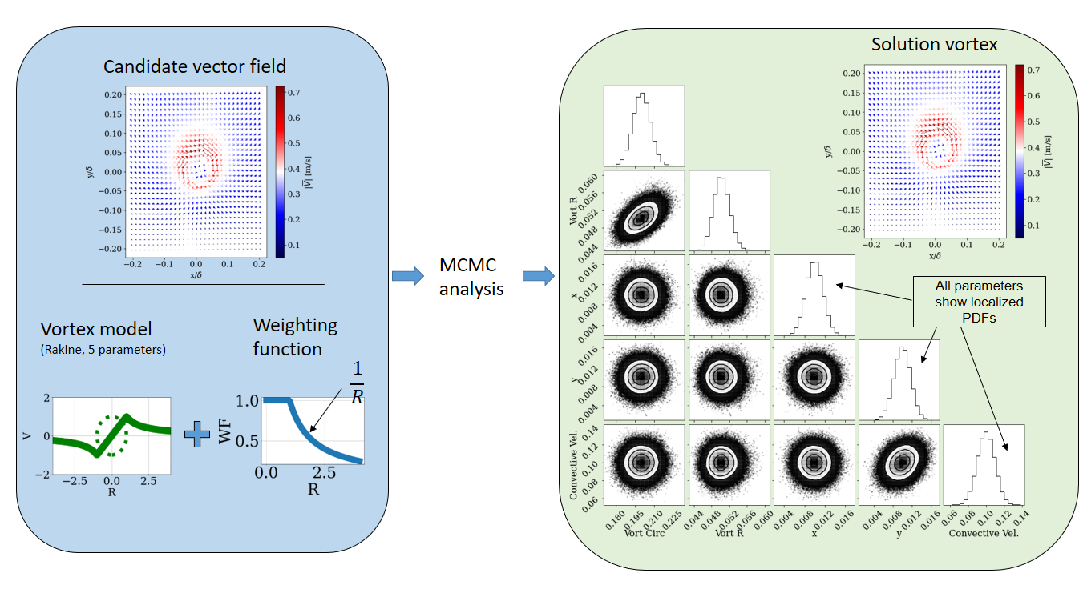
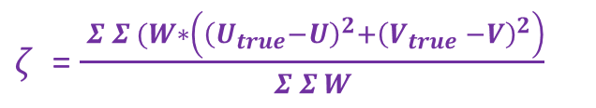
Overview: Vortex matching using MCMC
$ζ$ = $\frac{ Σ Σ (W∗\left({\left(U_{true}−U\right)}^{2}+{\left(V_{true} −V\right)}^{2}\right)}{Σ Σ W}$
Notes:
Here is the overview.
I begin by identifying a small regions that I believe *could* contain a vortex. This can be a very crude estimate.
Then I take a vortex model and a WF and implement matching with MCMC to extract the properties of a vortex that might be present in this region.
I am using a rankine vortex model that uses 5 parameters to model a vortex. And after implmementing mcmc I can observe the most likely values of these five parameters that would minimize the matching process.
the grid on the right is called as a corner plots. It is the output from MCMC. The probability density function corresponding to each parameter is identified using MCMC and can be observed on the diagonal. Since the vortex model has five parameters, we have obtained 5 PDFs corresponging to each parameter. Once we have the PDf we can estimate the parameter using say mean or median of the PDF.
In later slides, Ill present exactly how properties are extracted from once we have a PDF. Which is not triaival when PDFs ar noisy.

Slide 8
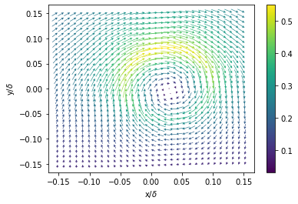
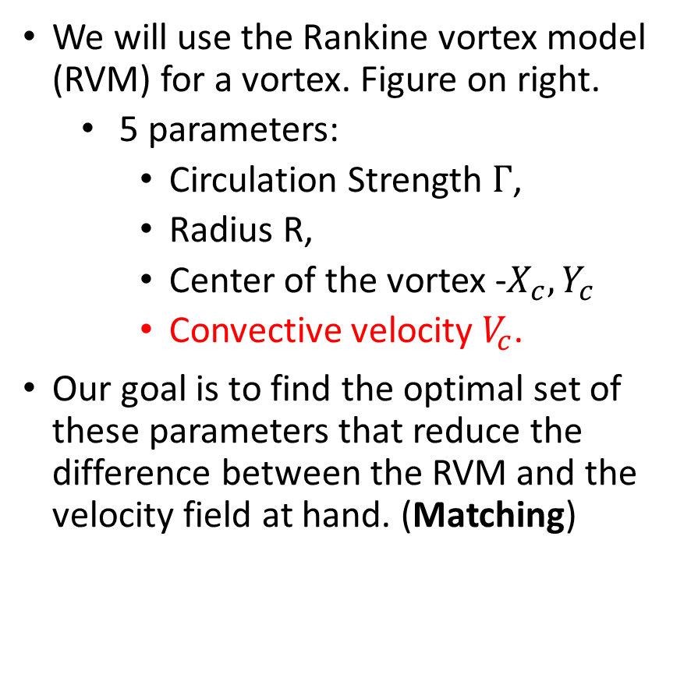
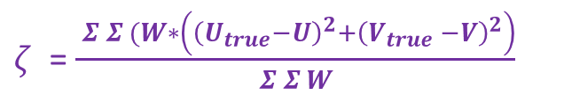
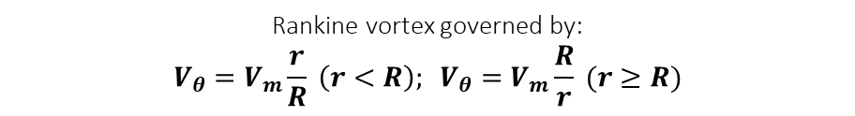
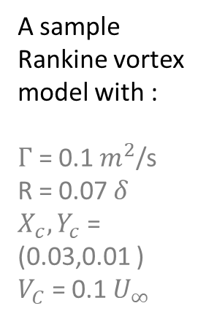
Matching model to data
Rankine vortex governed by:
$$V_{θ}=V_{m}\frac{r}{R} \left(r<R\right); V_{θ}=V_{m}\frac{R}{r} (r≥R)$$
We will use the Rankine vortex model (RVM) for a vortex. Figure on right.
5 parameters:
Circulation Strength $Γ$,
Radius R,
Center of the vortex -$X_{c}, Y_{c}$
Convective velocity $V_{c}$.
Our goal is to find the optimal set of these parameters that reduce the difference between the RVM and the velocity field at hand. (Matching)
A sample Rankine vortex model with :
$Γ$ = 0.1 $m^{2}$/s
R = 0.07 $δ$
$X_{c}, Y_{c}$ = (0.03,0.01 )
$V_{C}$ = 0.1 $U_{∞}$
$ζ$ = $\frac{ Σ Σ (W∗\left({\left(U_{true}−U\right)}^{2}+{\left(V_{true} −V\right)}^{2}\right)}{Σ Σ W}$
Notes:
I will go into detail on how we match the velocity field to a model.
We will use the Rankine vortex model (RVM) as I mentioned before.
5 parameters:
Circulation Strength $Γ$,
Radius R,
Center of the vortex -$X_{c}, Y_{c}$
Convective velocity $V_{c}$.
A vortex model with sample parameters can be seen on the right and the governing equations for an RVM can be seen on the top.
Our goal is to find the optimal vector of these parameters that reduce the difference between the vortex generated by the RVM and the velocity field at hand.
It should be noted that the difference is weighted to avoid interference from structures that are closer to the vortex candidate.

Slide 9
Overview: Vortex matching using MCMC
Notes:
Here we the overall framework should make much more sense now.
We begin with potential candidates,
Then based on the vortex model and the weighting function, we will do MCMC, and get the corer plot
From corner plot we can extract the properties of the vortex itself.

Slide 10
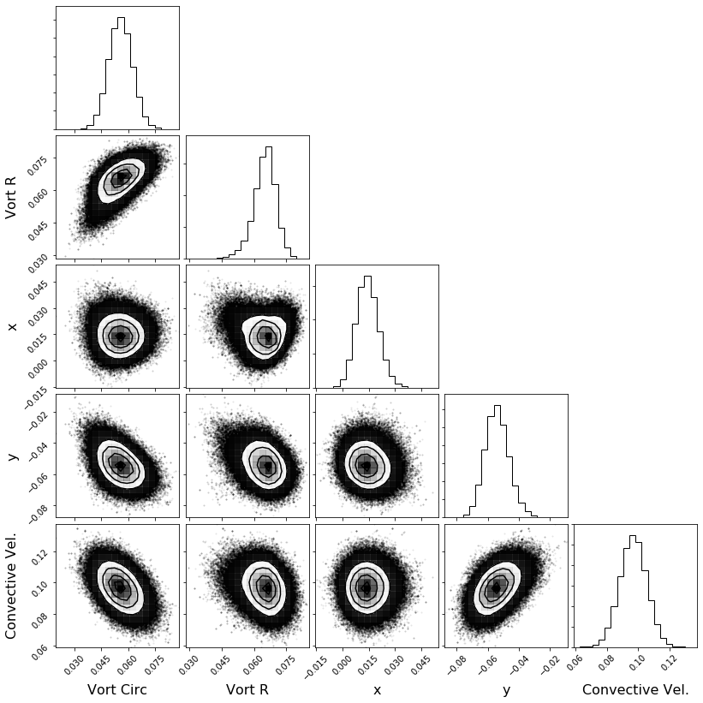
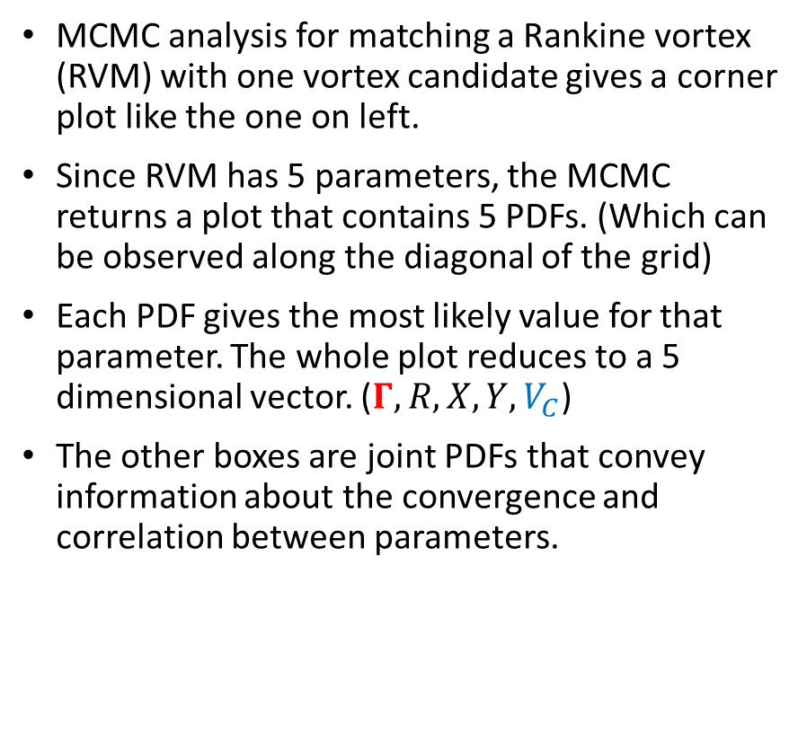
Bayesian Optimization – Single vortex
Circulation Strength PDF
MCMC analysis for matching a Rankine vortex (RVM) with one vortex candidate gives a corner plot like the one on left.
Since RVM has 5 parameters, the MCMC returns a plot that contains 5 PDFs. (Which can be observed along the diagonal of the grid)
Each PDF gives the most likely value for that parameter. The whole plot reduces to a 5 dimensional vector. ($Γ, R,X, Y, V_{C}$)
The other boxes are joint PDFs that convey information about the convergence and correlation between parameters.
Core Radius PDF
Center x – position PDF
Center y – position PDF
Velocity field of a vortex candidate that we want to match with RVM
Convective Velocity PDF
MCMC
Peak value!
Notes:
I will show how we can analyze a corner plot in this slide. So, this is what MCMC on a single vortex candidate would return.
I.e. It is an example of the matching on a single vortex vector field.
It gives a plot like the one on the left. It is called as the corner plot of optimization.
Since RVM has 5 parameters, the MCMC returns a plot that contains 5 PDFs. (Which can be observed along the diagonal of the grid)
Beginning from the top left corenr we have the pdfs for CS, R, X and so on.
Each PDF gives the most likely value for that parameter. The whole plot reduces to a 5 dimensional vector. ($Γ, R,X, Y, V_{C}$)
Which contains 5 values. An sample of extracting a value from PDF is shown in red, corresponding to CS. This is done using a Gaussian fitting on the peak.
It is important to note that CV which is one of the parameters of RVM, is also a byproduct of the BO, as seen in blue.! And need not be explicitly known beforehand.
For completeness , I wana mentinos that
The other boxes are joint PDFs that convey information about the convergence and correlation between parameters
To sum things up, we begin with a Velocity field of a vortex candidate that we want to match with RVM
apply mcmc, get corenr plot and extract vortex properties of the candidate that we have identified.

Slide 11
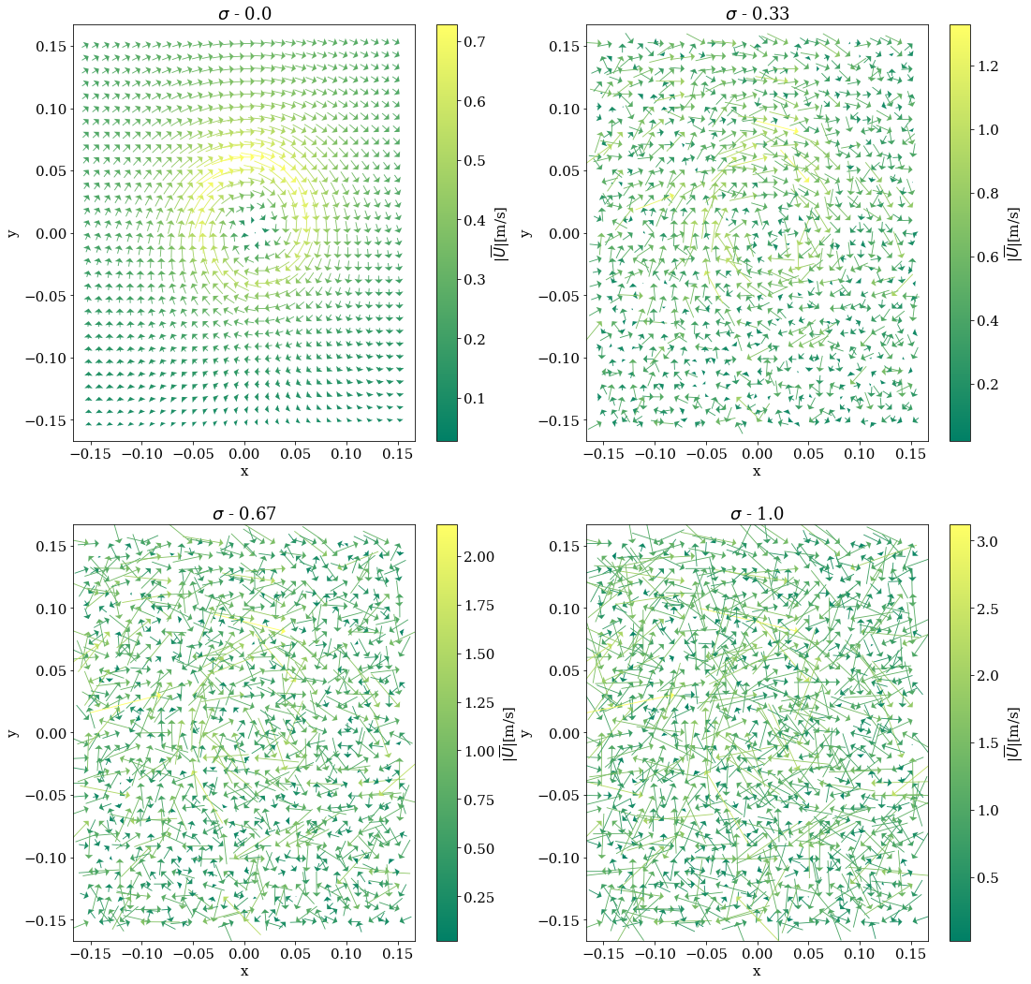
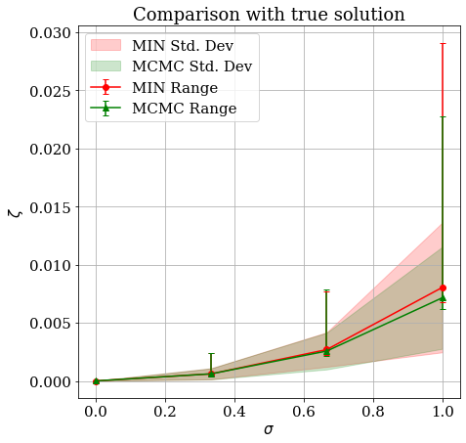
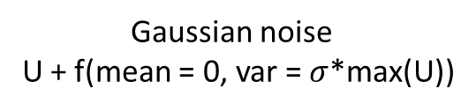
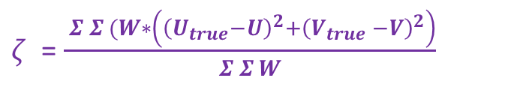
Performance against noise – overall error
MCMC performs better than under noise than truncated Newton’s (TNC) method based optimization.
$ζ$ = $\frac{ Σ Σ (W∗\left({\left(U_{true}−U\right)}^{2}+{\left(V_{true} −V\right)}^{2}\right)}{Σ Σ W}$
Gaussian noise
U + f(mean = 0, var = $σ$*max(U))
Notes:
This marks the end of how MCMC is used to match vortices. Now in the coming slides, first I will show an analyss on how MCMC performs on synthetic data. Then we will look at actual PIV data later.
Here, I’m comparing the performance of vortex matching with increasing amounts of Gaussian noise using both MCMC and a simple traditional minimization approach.
For this I have used truncated newtons approach. This comparison between MCMC and MINN is made through out the later results to have a base line to compare with.
Also to measure the error in matching, I have used the weighted mean squared difference which is represented by zeta.
The first figure shows vortex candidates with increasing amounts of Gaussian noise and the second figure shows the zeta error for MCMC and regular minimation. Both perform really well upto a certain noise and then MCMC performs starts to perform better.
In order make the results independent of the randomness in the noise, I have repeated the results with multiple seeds and plotted the statistics for different runs.
The ultimate results is that MCMC is
better in terms of the overall mean, range and standard deviation of errors.
Since

Slide 12
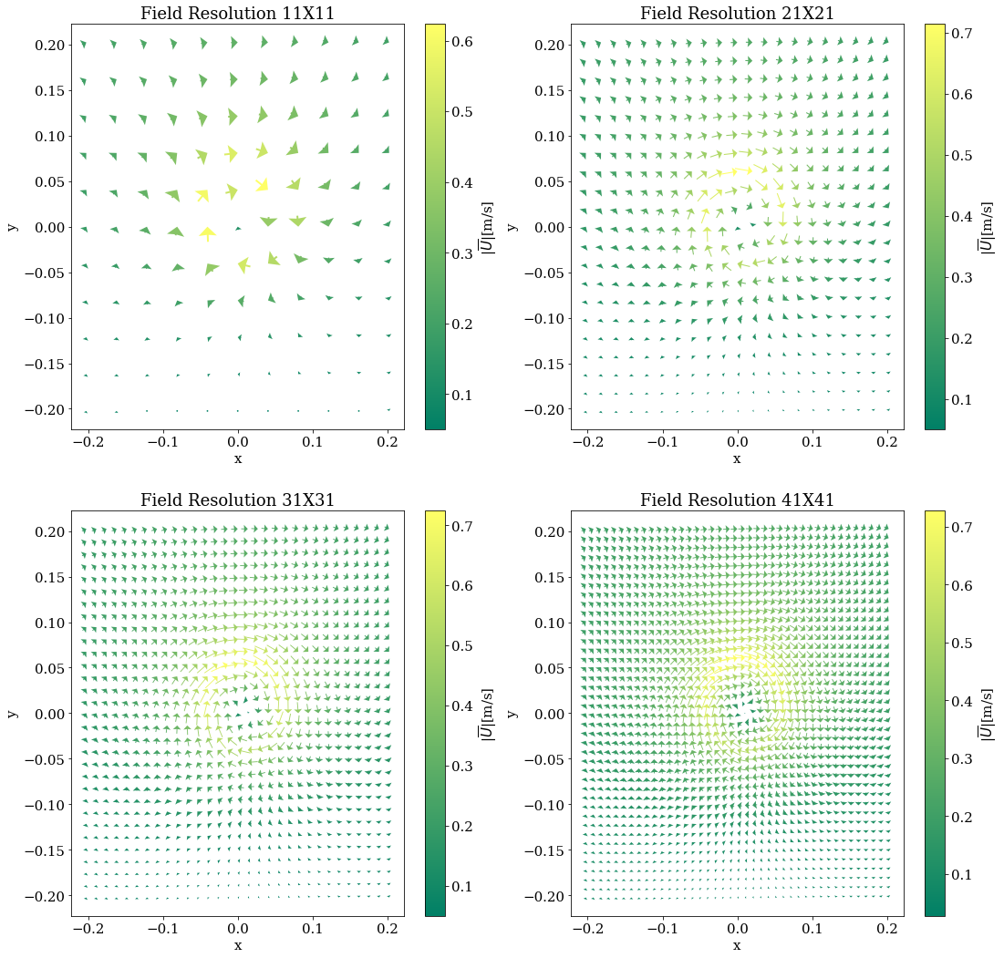
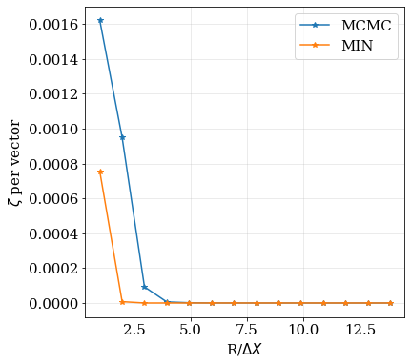
Performance against decreasing resolution
Resolution threshold
Notes:
Similarly,
These plots show the performance of resolution on the optimization process.
Figures on the left show increasing amounts of resolution and we can use this analysis to identify where each optimization technique breaks down.
Here MIN appears to performs better compared to MCMC at lower resolution but beyond the threshold
Both perform equally well.
But,
Since the resolution in PIV measurements is constant,
this plot was crucial to determine the threshold at vortex candidates are considered insignificant. i.e. around 5 pixels.
If a candidate is identified which is smaller than 5 pixels then it is deemed unfit for optimization using the current framework.

Slide 13
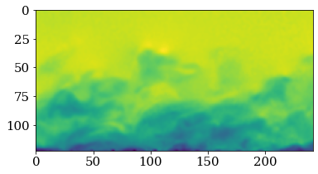
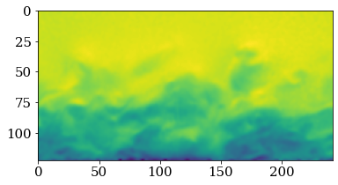
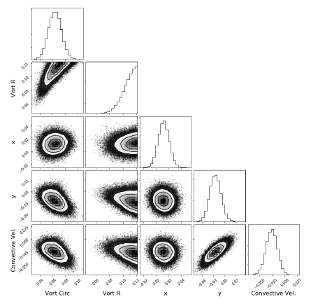
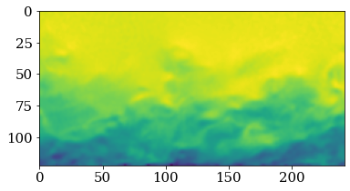

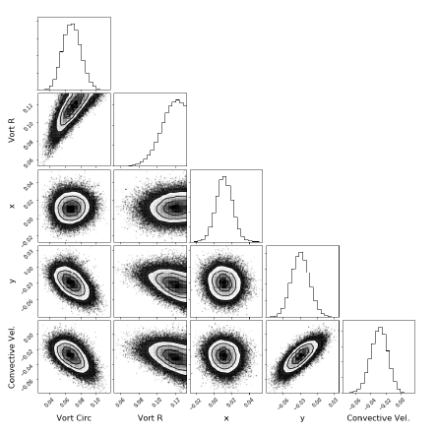
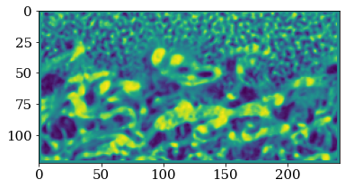
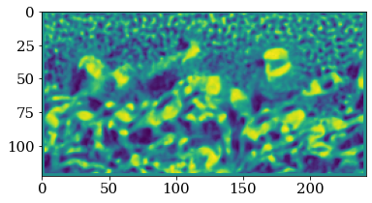
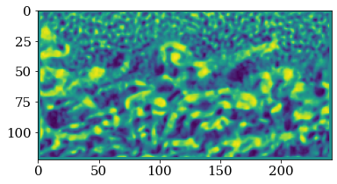
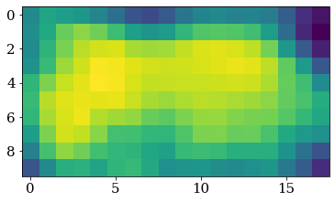
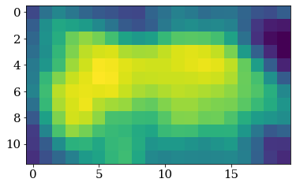
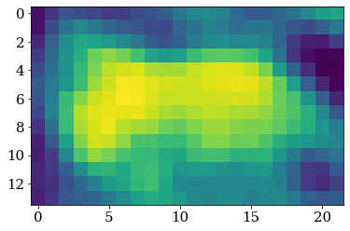
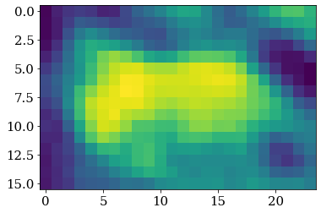
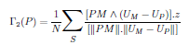
Candidate identification
MCMC, PDF interpretation and iterative windowing.
diverged
diverged
Vortex properties using Gaussian fitting.
diverged
converged
$Γ=0.65$, $R=0.18, X_{C}=0.016$, $Y_{C}=−0.032$, $V_{c}$ = -0.031.
Iteration #1
Iteration #2
Iteration #3
$Γ_{2}$ fields
Iteration #n
Notes:
Now we move on to looking at applying MCMC on PIV data.
We begin by looking at the velocity fields and calculating their Tau 2 fields. proposed by Graftieaux et al. (2001) Tau 2 is an Galilean invariant scalar operator that tells us if a point is
Inside or outside a vortex core.
From this fields initial estimates of potential vortex candidates are made and Regions are isolated using bounding boxes.
A Bounding Box is put over each candidate and MCMC is evaluated to match and learn the vortex properties.
If the MCMC returns corner plots that contains diverged PDFs then the size of the bounding box is increased until the corner solution returns converged solution. In the middle plot we can see different iteration going on until we get convergence in corner plots.
Finally once we get a converged corner plots, the properties of vortex are extracted.
The output for an example candidate is shown in the right panel.

Slide 14
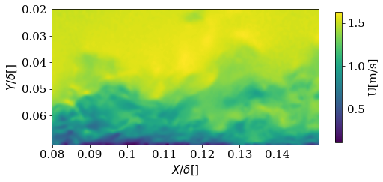
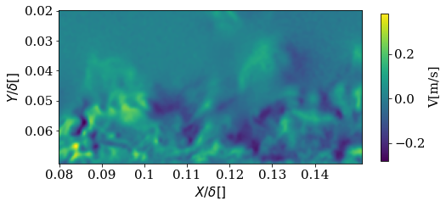
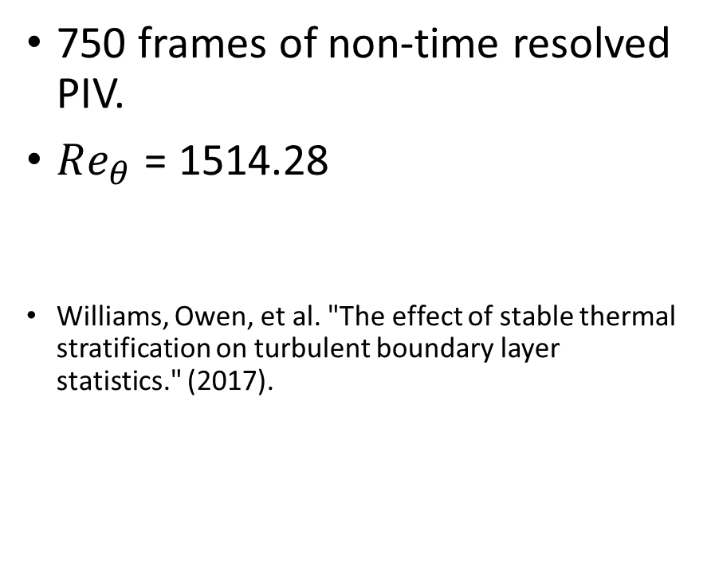
Boundary layer flow PIV dataset
750 frames of non-time resolved PIV.
$Re_{θ}$ = 1514.28
Williams, Owen, et al. "The effect of stable thermal stratification on turbulent boundary layer statistics." (2017).
Notes:
This is the PIV dataset that is used in current analysis.
There are 750 frames of non-time resolved PIV. (non-time resolved is not resolved in time and hence statistically independant)
The Re number based on momentum thickness of the boundary layer is ~1500.
And here is an example frame showing the stream wise and wall normal velocity components. Of a single frame in this dataset.

Slide 15
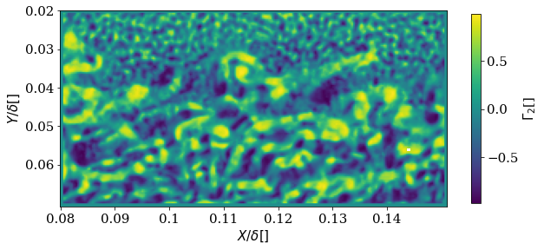
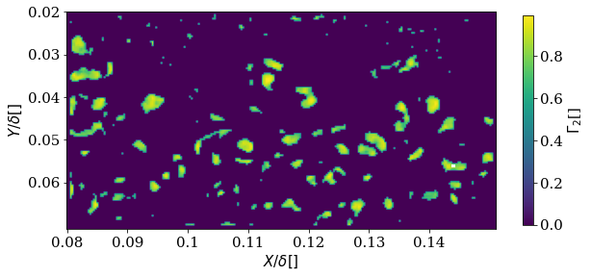
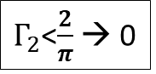
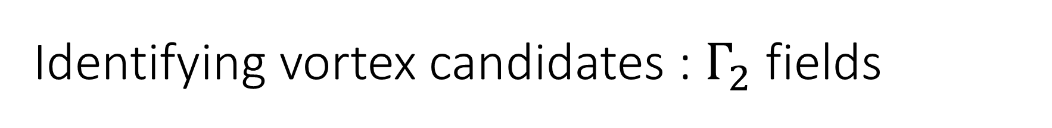
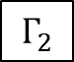
Identifying vortex candidates : $Γ_{2}$ fields
$$Γ_{2}$$
$Γ_{2}$<$\frac{2}{π}$ → 0
Notes:
Now focusing more closely on how to identify potential vortex candidates:
the tau 2 function is used. The Tau 2 equation is also noted here for reference.
The Tau 2 is an operator that works on all the points present in the field.
This expression boils down to calculating the average sin theta value of the angle which the neighbouring vectors make starting from P make.
For example if P is at the center fo the vortex core, all the surroungin velocity vecotrs would be perpendicular. And the average of sines would returns a value of 1.
So tau 2 maximizes with 1 at the center of the vortex core.
Tau 2 can also be used to decide if a point is inside or outsie a vortex core.
If the value is less than 2/pi then its outside if not then its inside.
By using this threshold a new Tau 2 field is generated whcich shows potential vortex candidate blobs.
(original Tau 2 field is show on right and after apply threshold the field looks like the one on the left)
Then 2D peak prmnence is used to identify significant peak and then MCMC is applie to extract properties of all blobs in a frame.

Slide 16
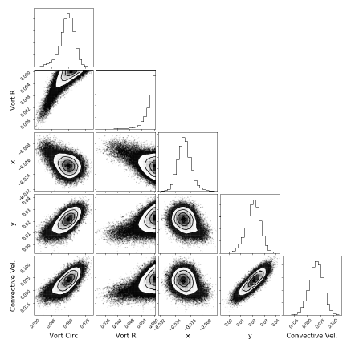
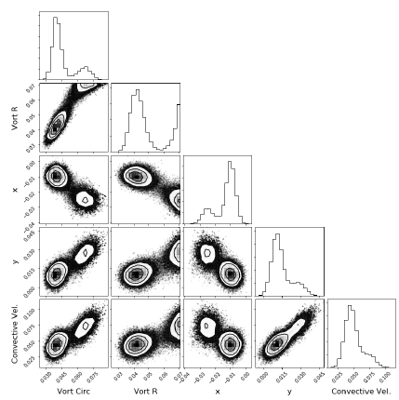
Corrections to bounding boxes of vortex candidates.
How to rectify:
Increase the size of bounding box.
How to rectify:
Consider the tallest peak.
Divergence of PDF
Multiple peaks in PDF
Notes:
There can be a few problems with Bayesian Optimization, they always do not have converged PDFs in their corner plots.
Sometimes there is total divergence (like the PDF correspongin to the second parameter in the first plot) and sometimes there may be multiple peaks. (like the second plot)
The first problem, Divergence is harder to resolve–
Divergence in the radius parameter (that is the second parameter here) iindicates optimization is seeking the maximum.
This means probably BB is small, so increase BB size and do MCMC again.
The second case, with
Multiple peaks is simple – we only consider the tallest peak for evaluation of optimal value.

Slide 17
Candidate identification
MCMC, PDF interpretation and iterative windowing.
diverged
diverged
Vortex properties using Gaussian fitting.
diverged
converged
$Γ=0.65$, $R=0.18, X_{C}=0.016$, $Y_{C}=−0.032$, $V_{c}$ = -0.031.
Iteration #1
Iteration #2
Iteration #3
$Γ_{2}$ fields
Iteration #n
Notes:
I think referring back to the the overview, all the working parts of the framework should be clear.
Now lets look at a the results of implementing this algorithm on actual piv data.

Slide 18
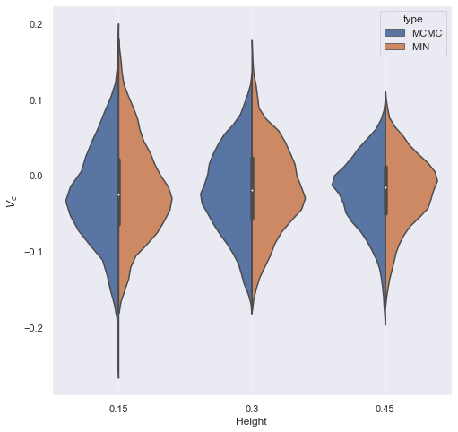
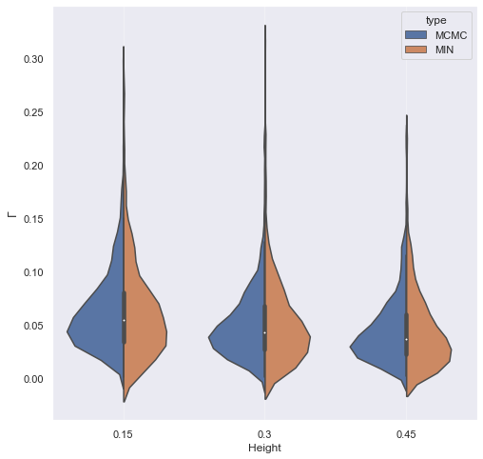
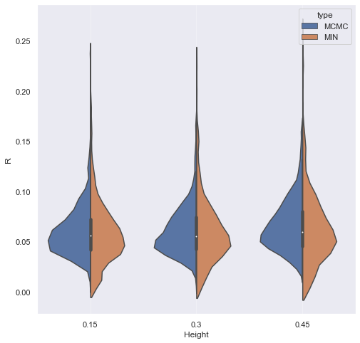
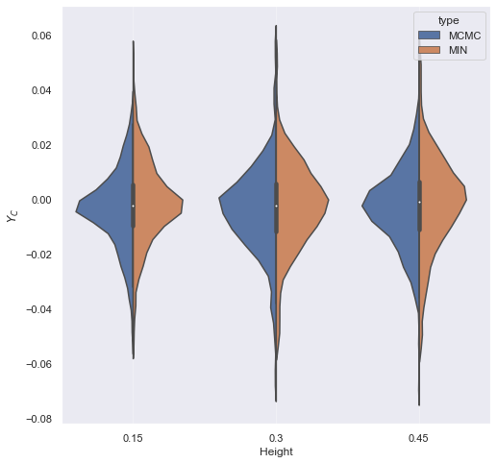
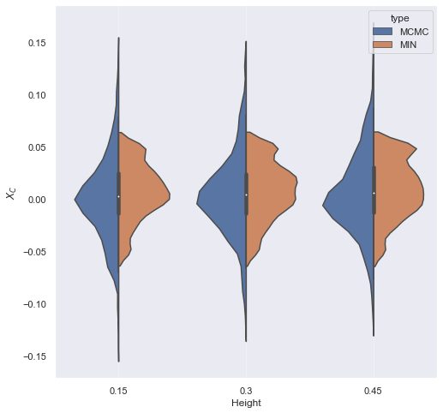






Results on PIV data.
$$V_{c}$$
$$Γ$$
$$R$$
Results at three different heights, $\frac{y}{δ}$ = 0.15, 0.3 and 0.45
Comparison of cumulative parameter distributions based on the type of optimization used.
From 750 frames of PIV data, 364, 299 and 300 candidates were identified respectively at those heights.
$$X_{C}$$
$$Y_{C}$$
Notes:
These plots show cumulative distributions the properties of all vortices identified.
Since we are working with 5 parameters, I have plotted all five of them here.
They are segregated in heights at which the vortices are found. The heights considered are 0.15 0.3 and 0.45. These values are the vertical heights that were non-dimensionalised with respect to the boundary layer thick ness.
At each height the distribution of parameters are shown using these violin plots, On the left side of each violin plot it shows the results obtained using MCMC in blue.
One the right side, the results are obtained using minimization.
These are results from 750 frames of PIV that identified 364, 299 and 300 vortices at those three heights.
Over all the distribution of parameters is much smoother for MCMC compared to minimization. Which is clearly evident from the Y and R parameters.

Slide 19


Results on PIV data.
A closer look at the cumulative properties of the convective velocity of all vortex structures segregated by the height at which they are evolving.
The velocity of structures is closer to free stream velocity as we move farther away from the wall.
$$V_{c}$$
$$\frac{y}{δ}$$
Notes:
A closer look at the cumulative properties of the convective velocity of all vortex structures is shown here. Again, they are segregated by the height at which they are evolving.
The velocity of structures is closer to free stream velocity as we move farther away from the wall.
Also, the vortices closer to the wall are more varying and the vortices farther away show narrower distributions. This suggests that vortices farther away from the wall are more closely approaching the mean flow profile which is consistent with boundary layer theory.

Slide 20


Results on PIV data - Error.
Box plots – zeta error – MCMC (left), TNC (right) at 3 heights
Zeta error on X axis, Type of optimization on Y axis.
Plot shows Mean, Median, Standard deviation and range of errors.
MCMC shows lower errors for all statistics at all three heights.
Notes:
In order to provide a more quantitative evaluation of performance, I will now present the Weighted MSDE, that it the zeta function.
These are all box plots that shows Mean, Median, Standard deviation and range of errors.
Zeta error on X axis.
Type of optimization on Y axis.
MCMC on left and TNC or MIN on right.
MCMC shows lower errors for all statistics shown like mean, meadiaun and range and so on.
This is consistent at all heights.

Slide 21

Conclusions
A Bayesian framework is established to automate multi-scale vortex identification without the knowledge of the convective velocity of the structure.
The effects due to noise and resolution on the optimization process are studies.
Successfully identified vortices that are too close to one another.
MCMC results on true PIV data show lower mean, median and range of $ζ$ error compared to Minimization.
This automated identification framework lays the ground work for other higher dimensional coherent structure models.
Python code available on GITHUB at
https://github.com/kommalapatisahil/CoherentStructures
Notes:
Here are the conclusions to the first part of my thesis.
A Bayesian framework is established to automate multi-scale vortex identification without the knowledge of the convective velocity of the structure.
The effects due to noise and resolution on the optimization process are studies. That is mcmc is better at handling noise.
But performs poorly at low resolutions, but an ideal threshold is identified to handle this issue which is implemented in the later steps.
Successfully identified vortices that are too close to one another. And iteratively rectified the size of the bounding box.
MCMC results on true PIV data show lower mean, median and range of $Weighter MSDE$ error compared to Minimization.
This automated identification framework lays the ground work for other higher dimensional coherent structure models.
All the code is written in python and openly available at this following lnk.

Slide 22
Broad Objectives
Bayesian Inference for turbulent coherent structure Identification using PIV measurements of Boundary layer flows.
Shallow Neural Networks for super resolution in PIV measurements of turbulent separated flows.
Notes:
Lets focus on the second objective of this work.
Using Artificial Neural Networks for super resolution in PIV measurements of turbulent separated flows.

Slide 23

What is super resolution (SR) ?
Reference : http://intouchlabels.com/blog/resolution-solutions/
Tools and techniques that enhance the resolution of an image or Image like system.
SR in fluid measurements can benefit both experimental and numerical approaches.
The multi scale nature of turbulent flows especially makes this challenging.
Notes:
Tools and techniques that enhance the resolution of an image or Image like system which includes fluids and other physics based simulations.
SR in fluid measurements can benefit both experimental (like PIV ) and numerical approaches (CFD).
The multi scale nature of turbulent flows especially makes this challenging.
If we look at the picture, SR aims to learn a map that could transforms an image from LR to HR, so from the rhs to the lhs.

Slide 24
Objectives for current work.
Understanding classical SR approaches.
SR of PIV measurements using Shallow Neural Networks (ANN).
Estimating the magnitude of training dataset that is sufficient.
Looking at the effect of SR on instantaneous flow measurements and their overall turbulent characteristics (derived quantities).
Notes:
Here are the objectives for the current work:
Understanding classical SR approaches.
SR of PIV measurements using Artificial Neural Networks.
Estimating the magnitude of training dataset that is sufficient to train the ANN model.
Looking at the effect of SR on instantaneous flow measurements and also the overall turbulent characteristics.

Slide 25





Separated Flow Dataset.
50,000 such non-time resolved snapshots.
PIV Set up Image - M. Robbins, “Detailed Characterization of Flowfields and Uncertainty in a Speed-Bump Turbulent Separated Flow Validation Experiment“
$$U_{∞}$$
U = $\tilde{U}+U′$
$\tilde{U}$ - Velocity mean
$U′$ - velocity fluctuations.
$U_{n}^{′}$ - normalized velocity fluctuations.
Flow conditions: 40 m/s, $Re_{L}$ = 2.095 x${10}^{6}$ , $Re_{H}$ = 1.795 x${10}^{5}$
X, Y are normalized with respect to bump height , H = 0.0766m.
Notes:
This is the dataset used for SR research.
It is a turbulent separated flow captured over a speed bump with a Gaussian cross sectional profile.
Collected using PIV. And Here is the set up.
The green light is laser, and we can notice a bump underneath it.
The FOV is fixed on the separated flow over the bump, highlighted in red.
This is turbulent and rich in detail, which would be an ideal of researching super resolution.
An example PIV snapshot is shown on the top. This is the stream wise velocity plot and the flow direction is shown in red, from right to left.
The data is pre processed to fill missing values by imputing using the k nearest neighbors algorithms.
I also wanna mention the nomenclature used through out these slides. The flow is decomposed in to the mean field and fluctuations. U tilde refers to the stream wise mean the u dash refer to the fluctuations. Finally the fluctuations are also locally normalized and these fields are represented by u dash with a subscript of n.

Slide 26

Non-ML SR
*Bilinear Interpolation based average pooling was done.
Down-sampling the Image.
Reference : : https://www.geeksforgeeks.org/cnn-introduction-to-pooling-layer/
Notes:
Now, using PIV we have a dataset with high resolution images
SR is mapping from a LR to HR.
Need to generate LR.
A common technique to downsample images is average pooling.
It replace each block with their corresponging averages and this reduces
The overall size in the process.
Here the example shows a 2 by 2 filter. In my work, I used a three by three filter for three time downsampling which will be consistent for all results shown next.

Slide 27


Non-ML SR
Down-sampling the Image. (3X)
Notes:
Example snapshot (after the pre-processsing) that has 3x downsampling Avg. pooling.
Clearly the finer details are lost and the LR looks more blurry.
So, how do we go back?
Use SR.

Slide 28







Non-ML SR
Interpolation based methods.
Linear ($L_{SR}=0.2012$)
Bicubic ($L_{SR}=0.2031$)
quintic ($L_{SR}=0.2039$)
Notes:
Before moving forward, I wanna point out the
the popular non-ML based SR (that have been around since 60s)
Here three popular methods are used: the linear, bicuic and quantic.
Linear is a fist ordered method that takes two points, one in either direction, and solves for the intermediate value.
Bicubic interpolates uusing a cubic polynomial and hence needs 4 points
Quintic uses a 5th ordered polynomial and takes 6 points.
These were all completed the scipy’s interpolate module.
But these all look very similar, how do we know how good they are?
We use a norm based percentage difference estimate given denoted by L sr. (super resolution loss)
For this specific example, all interpolation techniques have a loss of appraoximately 0.2.

Slide 29

SR Using ANNs.
Artificial neural networks are a sub class of Machine Learning models.
ANNs are sequentially arranged network of nodes that transfer signals through weighed connections.
By giving examples of an input and output values (or fields) the ANN learns to optimize its weights to learn the underlying relationship between the input-output pair.
Universal approximation theorem. Cybenko (1989)
F(x;w)
x
F( _ ;w)
Notes:
Brief intro to Anns.
Artificial neural networks are a sub class of Machine Learning models.
They are bio inspired algorithms modelled after biological brains, more specifically from cats.
In a black box, ANNs are a networks of nodes that are sequentially arranged and transfer signals from one another through weighted connections.
By giving examples of input and output values (or fields) the ANN learns to optimize the weights between its nodes and learns the underlying relationship between the input-output pair.
In order to train the ANN accurately, depending on the nature of the underlying relationship a large number of these input-output pairs might be required.
It is also important to make sure these samples are sufficiently independent from one another provides a new piece of information about the underlying process.
Here is a skeleton of an ANN that takes an input x and returns an output f(x) based on the weihts of the ann.
An important property of Anns was proved by George cybenko in 1989 which states that Neural networks that have suffiently large number of
Hidden layers can learn the an arbitrarily complicated relationship between the inputs and the outputs.
This is very useful for a lot of engineering applications given the extremely non-linear nature governing physics of various natural phenomenon.
This motivates us to use anns for sr.

Slide 30

SR Using ANNs.
Notes:
Here is the ANN based framework for SR.
We initially train the weights of an ANN by feeding it the lr snapshots as inputs and the hr snapshots as outputs.
After training with sufficienly large dataset, the weights would theoretically learn the relationship to map the lr inputs into the hr outputs
Essentially implementing sr.

Slide 31


SR Using ANNs.
How much data should be used for training?
No improvement beyond 10,000 frames.
For further implementations a training dataset with 20,000 frames and a validation dataset with 5000 frames is considered.
Notes:
The L SR loss metric is referred to again.
This time the average of SR for all frames in the validation dataset is calculated and compared for training datasets with different magnitudes.
It looks like theres not much difference between 10K and 50K frames.
So, For further implementation a training dataset with 20,000 frames and a validation dataset with 5000 frames is considered.
Now that we know data magnitude, we looks at model structure.

Slide 32

ANN tuning: Tensorflow’s tensorboad callback
# of Layers
# of units in each layer
Activation function
Optimizer
Loss at the end of training
Notes:
The weights of an ANN are optimized during the training process, but
Before training there are a lot of other parameters, called hyper parameters that are needed to be set for efficient training.
These hyper parameters include the number of hidden layers in the ANN, the number of units in each hidden layer, the kind of activation in each unit
And so on.
One way is to manually run ‘n’ different anns each with a different setups and see how they perform.
But this can be automated using tesorflow’s tensorbord callback.
This enables us to not only just find the optimal set up, but also learn the sensitivity of each hyper parameter.
In this plot, I have tested out a few different hyperparameters for the
Numb of hdden layers, the numib of units, th activation function, the optimizer to upate weights and monitord the loss for each set up.
I have circled the optimal set up, but I can also see changing which parameters had the most and least influence on the loss
By looking at the colormap of the connectoins.

Slide 33


Optimally tuned ANN architecture.
1 hidden layer – 1500 neurons.
Exponential linear unit as the activation for hidden layer. Tanh() as the activation for output layer.
Step wise decaying learning rate profile.
ADAM optimizer.
L2 difference as the training loss function.
Early stopping callback.
Trained with 20,000 training frames + 5,000 validation frames
Notes:
For this slide, I have made an assumption that the audience is familiar with the general terminology associated with
Neural network training.
By finely tuning the network using Tensorborad, I have arrived at the following architecture.
1 HL
1500 neurorns,
EXP lin unit as activation for hidden.
Tanh() act act for output
An exponentially decaying learning rate was given. This was found out to be the most influential factor in training
ADAM optimizer.
L2 difference was chosen as the training loss function.
An early stopping callback isset up to stop training if the losses do not decrease after 10 epochs.

Slide 34
SR Using ANNs.
Notes:
Going back o this,
Objective is 3 times super resolution,
The input size was 6k, utput size was 60k
This model with 1500 hidden has 100 mil parameter, (weights and biases)
So take a look at the training trends.

Slide 35



ML SR – training and validation losses.
Average $L_{SR}$ for bicubic interpolation – 0.1327 (Shown in green)
Notes:
Left – training and val – loss – L2 difference.
Right – train and val – evaluation metric – L SR loss.
So, there are two different losses. The training is done using an L2 norm of the difference. But L2 norm is unintuitive and it can arbitrarily low or big.
So to interpret results bettern the super resolution loss is also monitored as shown in right.
That explains the two plots, the one of left is the loss drivig the optimization and the one of right is for interpretation.
In both, we have train, val losses
The val data trends show true trends that are do not account model overfitting.
I have calculated the average L SR by using a bicubic interpolation and added this to the training metric plot on the right, in green
This way, I can see that the ANN beats the performance of bicubic interpolation after 20 epochs of training.

Slide 36



ML SR - Reconstructions
Low resolution
High resolution (3X)
ANN SR
Bi-cubic SR
$$L_{SR}=\text{0}\text{.}\text{2031}$$
$$L_{SR}=\text{0}\text{.}\text{1766.}$$
Notes:
Lets closely looks at an example of reconstruction .
Thse are all instantaneous turbulent fluctuations measured using PIV
Top left LR
Top right HR
Bottom left is bicub with a Lsr error of 0.2031
Bottom right is ANN sr with lsr = 0.1766.
This trend of ANN performing better than other interpolation based methods is very consisten,
But there are definitely a few exception that I have found. But again, the overall average error is lower by using an ann.

Slide 37

ML SR – comparison
Performs comparatively better than other interpolation methods.
~ 32% lower loss.
Notes:
Previous plots show one instantaneous field and this plot shows the overall performance on 5000 images.
The mean median and the variance and range of the loss are visualized using the box plot.
Y axis shows the different SR techniques and x axis shows the Lsr error.
###Also here is the overall comparison of the average L SR losses for an ANN and other interpolation methods.
The take away is that SR with ANNs Performs comparatively better than other interpolation methods with a ~ 32% lower loss values.

Slide 38











ML SR – Turbulent Characteristics.
ANN SR - variance of $U_{n}′$
HR – True variance of $U_{n}′$
$$L_{SR}=\text{0.0164}$$
Bicubic Interpolation SR - variance of $U_{n}′$
Linear Interpolation SR - variance of $U_{n}′$
$$L_{SR}=\text{0.027}$$
$$L_{SR}=\text{0.}\text{0}\text{352}$$
Notes:
The instantaneous velocity fields are reconstructed with better accuracies, but if the physics is truly learned then
Turbulent derived quantities should also follow similar trend.
It should be noted that this is not trivial as the ANNs are oblivious to the physics at this point.
I have looked at the variance of stream wise velocity fluctuation from from reconstructed
High res samples from all sr techniques. This is the variance plot generated from 5000 reconstructed samples.
For reference, I have added the true variance of those sample on the top.
Next, I have the variance of U for the same corresponding fields that were generated using ANN,
And linear and bicubic interpolations.
For consistency, I have used the same L SR loss, to see how well the variance fields compare against the true value,
The L SR is a basically a percentage error measuee and it looks like all methods did well and are below 4% error.
The ANN performs significantly better than interpolation techniques. With ~1.6% error wrt to the true fields.

Slide 39


ML SR – Turbulent Characteristics.
Average of the maximum ($U_{n}′$) in all frames of validation dataset.
Checking potential vulnerabilities in ANNs.
Notes:
Since interpolation techniques interpolate between values, it is simpler to maintain the range of reconstruction.
However, ANNs do not face any such constraints and solely focus on minimizing loss function by sometimes resorting drastic
Measures that might be unintuitive or does not have any physical meaning.
So, to test the range of reconstructions, I have plotted the Average of the maximum ($U_{n}′$) in all frames of validation data set. Since, the data is normalized
The true HR field has 1 in every frame and the average is also one.
As expected, higher the order of interpolation, the better the range of reconstruction. So, it makes sense that quintic performs better than
Bicubic and it in turn performs better than linear.
It is nice to see the ANN outperform all of those. This is a simple check to see how well it learns the underlying physics.
Also, this can be used as measure to quantify the room the improvement in the current approach. Its currently shows 0.96 and it could be made closer to 1.

Slide 40
Conclusions
Identified the magnitude of data ideal for training SR models using PIV data.
Successfully shows ANNs can accurately perform SR on PIV data.
Identified that the performance is superior compared to traditional interpolation methods.
Validated the performance of ANNs by evaluating derived turbulent characteristics.
Python code available on GITHUB at
https://github.com/kommalapatisahil/superResolution
Notes:
Short version:
Here are the conclusions that summarize my results and the code is hosted online.
Long Version:
Identified the magnitude of data ideal for training SR models.
Successfully shows ANNs can accurately perform SR on PIV data.
Identified that the performance is superior compared to traditional interpolation methods.
Validated the performance of ANNs by evaluating derived turbulent characteristics.
Code is publicly available online
We are currently still working on this research, where my team is exploring residual neural networks with transfer learning and physics informed losses
to improve the accuracy in sr.

Slide 41
Acknowledgements
Research advised by
Prof. Owen Williams (UW-AA)
Prof. Steve Brunton (UW-ME)
Prof. Brian Polagye (UW-ME)
Dr. Jake VanderPlas (Google Research)
Research supported by
Herbold data science fellowship, 2020-21
Notes:
Here are my MS thesis advisors,
I have executed the work by myself,
But was advised by owen, steve, brian and jake
And my research was supported by the herbold fellowship.

Slide 42
Questions?
Thanks!
Notes:
And with that I open the floor for any question and than you!

Slide 43


SR Using ANNs.
How much data should be used for training?
Notes:
In the next two slides, I will showcase the results to identify the magnitude of dataset that was sufficient for training ANNS for SR.
Now that we have looked at the structure of an ANN, lets try to get a sense of how much
Data is required for training.
I have chosen a simple ANN structure for evaluating the needs of training data.
Here I have trained the ann using 10, 100, 1000 and 10,000 frames in the training data. A common validation set of 1000 frames was used for these cases.
From these plots training loss looks like its converging to a common value, but more data makes the convergence faster.
The spike in the losses can be attributed to using training data in mini-batches and not as a whole.
But the important metric is the validation losses. It shows that bigger datasets definietely reduce the losses, but both 1000 and 10,000 frames
Kinda show similar treands.
To be more certain about the magnitude, lets take a loot at another metric.

Slide 44





Gaussian fitting algorithm
Notes:
This is a peak finding algorithm based on Gaussian fitting to handle signals with noise and also with multiple peaks.
The algorithm is shown on an example signal here.
First, the tallest peak is identified, then 50% of the the relative height of this signal is used for Gaussian fitting
Then the mean of the Gaussian fit is taken as the peak of the entire signal.
This is how we get the value of a parameter from a Probability densisyt unction.

Slide 45





Performance against noise – Individual parameters

Slide 46





Performance against decreasing resolution – effect on Individual parameters

Slide 47


Pre-Processing
Notes:
First stage of Pre-processing happens while processing raw PIV itself
A small % of flow field pixels are corrupted, due to various forms of noise.
There are replaced by null values, so that each particular user has more freedom to comeup with methods to handle them.
And we have to handle them. So even scipy, numpy fail to handle null values effectively.
Eg. If you take the mean of an array that contains a null value, it would jist return null.
We don’t want to loose majority of info because a tiny prop is bad.
So, here is one technique.
You could simply replace the null with the average value of the neighbours.
This is done using the scikit learns impute module.
Here is an example snapshot before imputing and after.
Another tricky thing is to handle the bump.
Handling the null columsn
Making sure the sizes of each snapshot is consistent.

Slide 48

ML reconstructions comparison

Slide 49






Turbulent Characteristics - % difference
ANN SR – % difference variance of $U_{n}′$
Average – 2.9%
Bicubic Interpolation SR - % difference variance of $U_{n}′$
Linear Interpolation SR - % difference variance of $U_{n}′$
Average – 1.3%
Average – 2.7%
Notes:
I have looked at the variance of stream wise velocity fluctuation from from reconstructed
High res samples from all sr techniques. This is the variance plot generated from 5000 reconstructed samples.
For reference, I have added the true variance of those sample on the top.
Next, I have the variance of U for the same corresponding fields that were generated using ANN,
And linear and bicubic interpolations.
For consistency, I have used the same L SR loss, to see how well the variance fields compare against the true value,
The L SR is a basically a percentage error measuee and it looks like all methods did well and are below 4% error.
The ANN performs better than the linear interpolation but not as good as bicubic .
This is very interesting given that the overall average error for velocity fluctuation using ANN is a lot better copared to bicubc.

